Slide 1
Yearly Achievement Report 2026
Presenter’s Name : Brian Gabriel Alban
Presenter’s Dept.: EDT220
2026/10/06

Slide 2
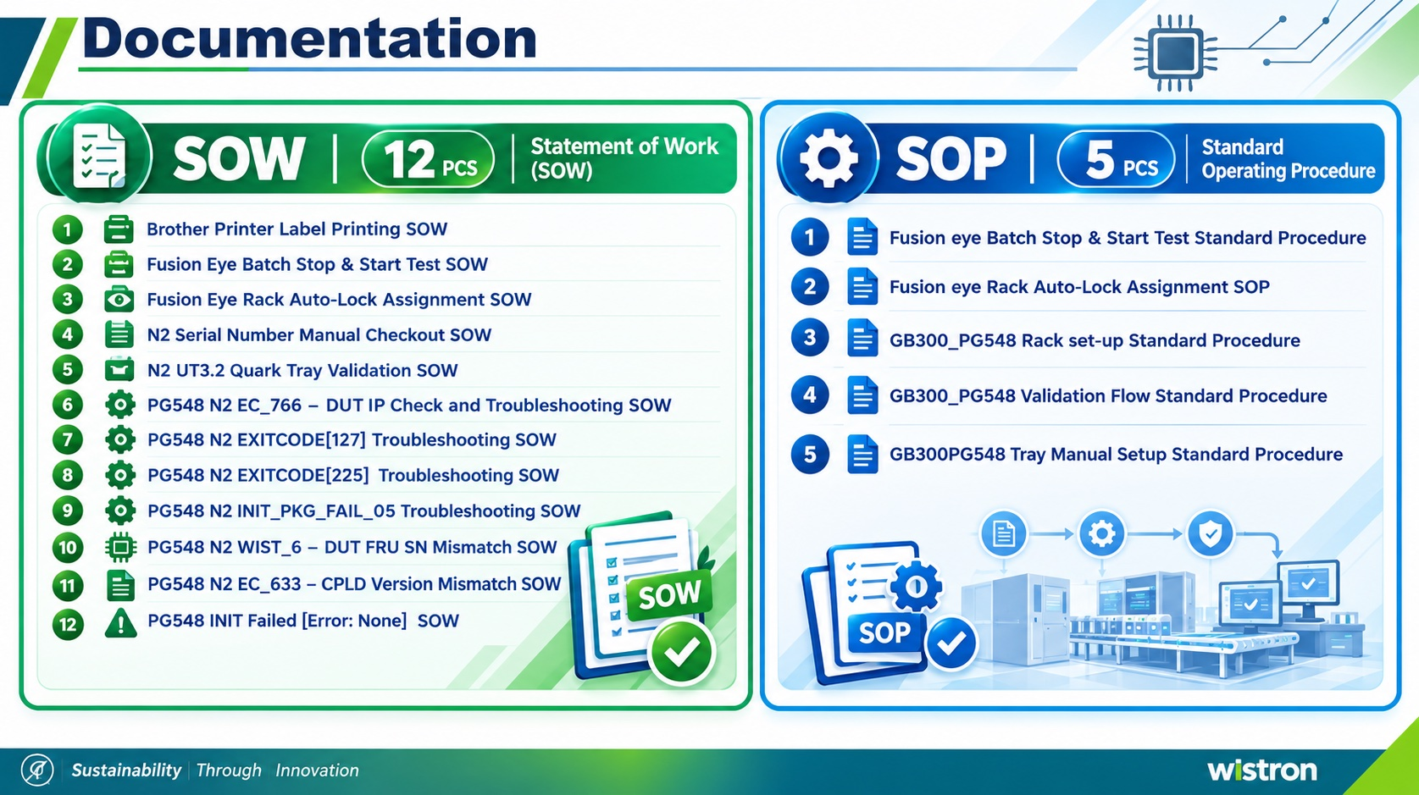


Documentation

Slide 3
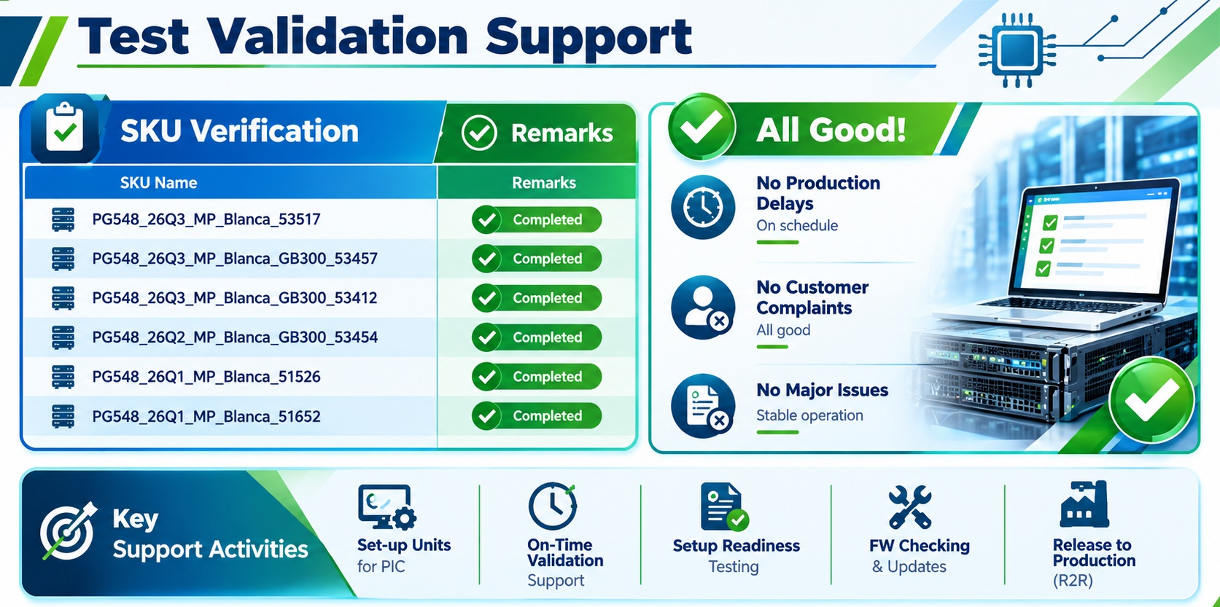
Test Validation Support

Slide 4
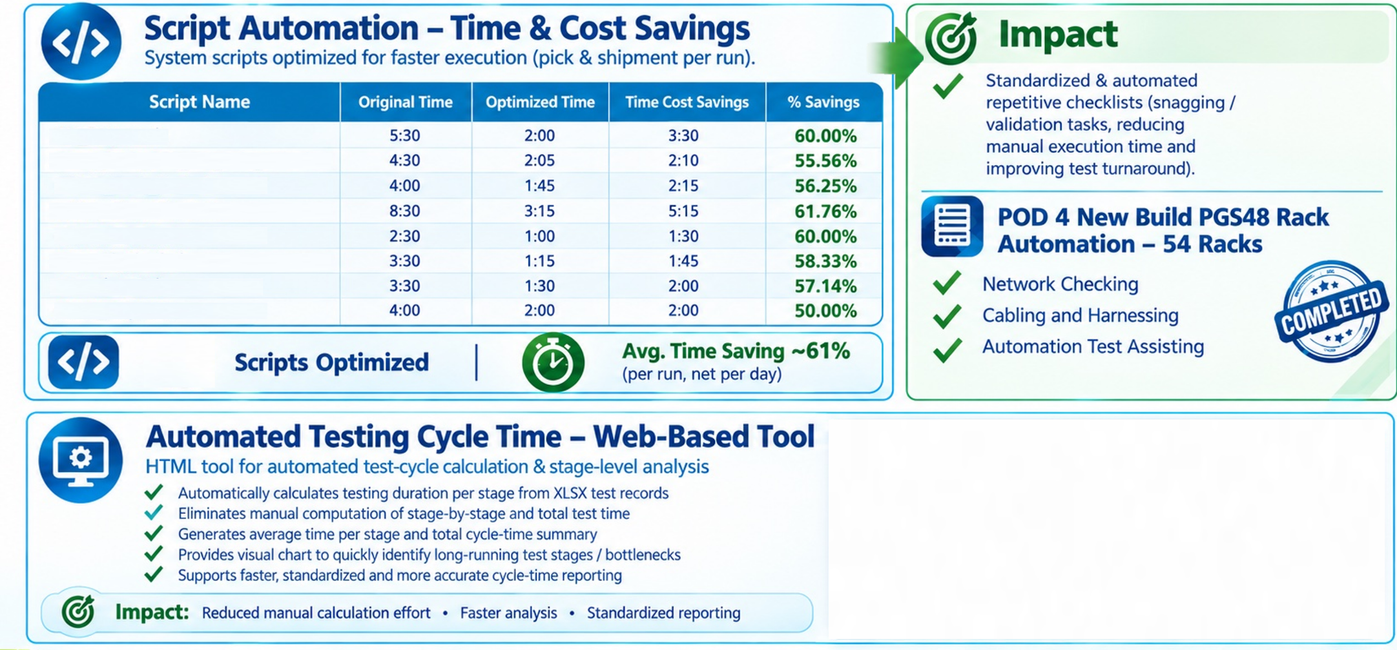
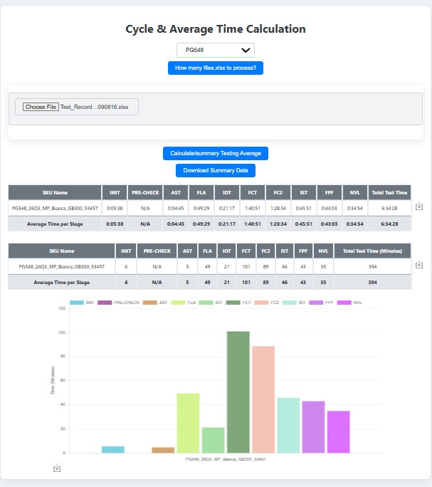

Major Contribution
RN_Repair.sh
Auto_Flash_PCIe_FW_local_vm.sh
PG548_Flash_FRU.sh
water_flow_check.sh
model_get.sh
get_sfcs_GETNVFRU2.sh
control_pg548.sh
cable_check.sh
8

Slide 5
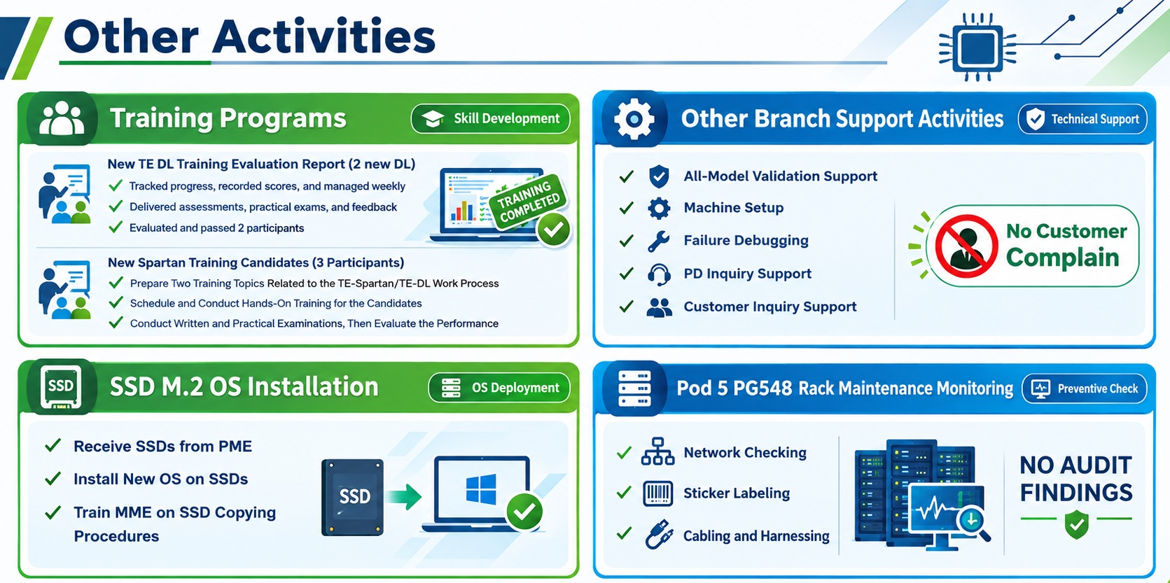
Other Activities

Slide 6
Thank You!

